Slide 1
Image Processing
Histogram Equalization
Histogram equalization is a very useful image processing technique that modifies the histogram of an image in order to increase its contrast.
While most of the time the output image has subjectively better quality than the original, this method also tends to amplify noise.
For this exercise you are task to apply histogram equalization on an image.

Slide 2
Image Processing
Histogram Equalization
The algorithm takes as input an image and calculates its histogram by iterating over every pixel value and increasing that value’s histogram by 1. Then, it calculates the cumulative sum (cdf) of the histogram, which is displayed on top of the histogram. Afterwards, it performs histogram equalization by calculating a new masked cdf and copying it to the output image. Then, it calculates the new histogram and displays it along with its cdf.
Finally, the original image is displayed alongside the equalized one.

Slide 3

Image Processing
Histogram Equalization
Input example.

Slide 4
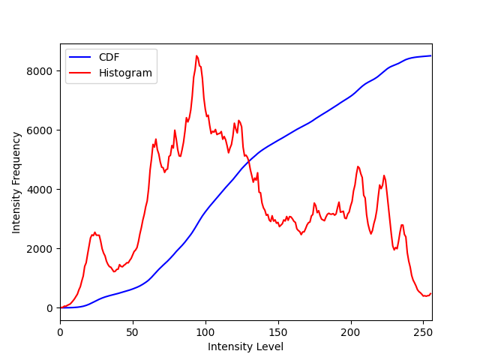
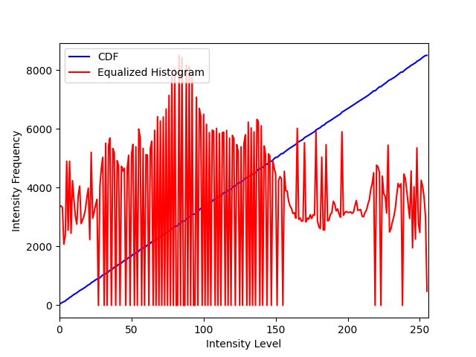
Image Processing
Histogram Equalization
Intermediate output examples (Original histogram (left) and equalized histogram (right).

Slide 5

Image Processing
Histogram Equalization
Intermediate output example (Original image (left) and equalized image (right).

